Slide 1
Detection and Estimation Theory Project Presentation
-Shannon Muthanna I B (IMT2022552)
- Margasahayam Venkatesh Chirag (IMT2022583)

Slide 2

Introduction
H₀- Null hypothesis, H₁- Alternative Hypothesis. NP rule:
For the NP detector to be implemented, both likelihood functions must be known and so, statistical models are assumed and parameters are estimated. Losses are calculated when this statistical model varies from the design.
For the proposed approach, no statistical model is to assumed and a good approximation for the optimal NP detector is obtained from choosing a relevant error function while training the ML model.
Drawback of the approach is the difficulty of obtaining training samples, and defining the most suitable learning machine architecture.

Slide 3
Previous Works
Basic NP Detector Approximation: Use a single-output learning machine compared to a threshold to decide between null (H₀​) and alternative (H₁​) hypotheses. The threshold sets the desired Probability of False Alarm (P_{FA}).
Alternative Implementations: Varies the bias of a single output neuron. Utilizes a two-output NN (outputs in (0,1)), comparing their subtraction to a threshold, which is equivalent to a single output with desired outputs {−1,1}.
Advanced Techniques: Radial Basis Function Neural Networks (RBFNN), Support Vector Machines (SVMs), and Committee Machines have also been applied for detection.
Supervised Training: Adaptive systems (learning machines) can approximate the Neyman-Pearson (NP) detector when trained in a supervised manner.
Suitable Error Functions: The Sum-of-Squares error is suitable for approximating the NP detector (and optimal for Gaussian signals). The Minkowski error with R=1 (Mean Absolute Deviation) is suitable for approximating the minimum probability of error classifier.
Future Work: Investigating alternative error functions suitable for non-Gaussian interference, ensuring they meet the sufficient condition for NP detector approximation.

Slide 4
Problem Statement
Consider a learning machine with one output, that is used to classify input vectors z = [z₁,z₂,...,z_{L}]^{T} into two hypotheses H₀ and H₁, that represent absence of target and its presence, respectively, in radar detection problems.
Given a decision rule, let Z_{i} be the set of all possible input vectors that will be assigned to hypothesis H_{i},and Z₀ ∪ Z₁ = Z the ensemble of all possible input vectors. The output of the learning machine is represented by F(z), and the desired output by t_{Hi} . A training set, Z = Z₀∪Z₁,where Z₁ is composed of N₁ training patterns from hypothesis H₁,and Z₀ is composed of N₀ training patterns from hypothesis H₀ (N = N₁ +N₀), is available.
The function the learning machine approximates to after training is obtained (as a function of the likelihood functions and the prior probabilities) and the implemented detector compares the learning machine output to a threshold η₀, which varies to fix the P_{FA}. The NP detector is usually implemented by comparing the likelihood ratio to a threshold η_{lr}, fixed according to the required P_{FA}.

Slide 5
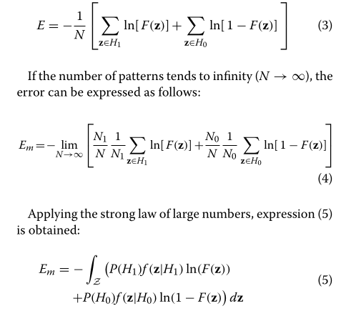
Proof of Concept
This section explains how the MLP’s output can be treated as an approximation of the NP detector
Law of Large Numbers
The law of large numbers states that given a sample of independent and identically distributed values, the sample mean converges to the true mean.
Equation three here denotes the cross entropy loss function at an MLP’s output.
For N tends to infinity, the sample mean of the function becomes true expected value of the function as shown in equation 5.

Slide 6


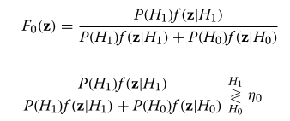
Proof of Concept
By Calculus of Variations, a function Fo(z) which minimizes the function/loss Em can be written using Euler-Lagrange:
Here the function I is the function inside the integral of the loss Em, Solving further we get Fo(z) as follows:

Slide 7
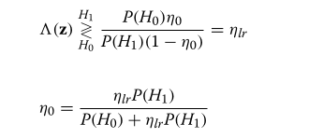
Proof of Concept
Extracting the Likelihood ratio from the above Fo(z) equation we get our new NP detector threshold as given below:

Slide 8
Experiments
Objective: Design Multilayer Perceptrons (MLPs) to approximate the performance of the optimum NP detector.
Challenge: Target parameters are unknown; therefore, the NP detector is approximated using an Average-Likelihood Ratio compared against a threshold.
MLP Structure: Real arithmetic MLP with L/M/1 architecture.
Input Layer (L=16): 8 complex radar echoes → 16 real inputs (in-phase and quadrature).
Hidden Layer (M): Number of neurons (M) is a studied parameter.
Output Layer (1): Compared to a hard threshold for detection.
Activation Function: Sigmoid.

Slide 9
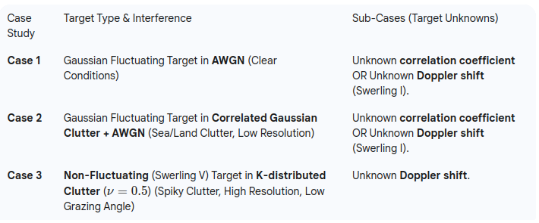
Experiments
Three Case Studies of Detection Problems: The studies assess the MLP's ability to approximate the NP optimum detector, focusing on diverse interference environments:

Slide 10
Experiments
Performance Comparison Strategies
The proposed MLP detectors are benchmarked using two primary strategies:
MLP vs. NP Approximation:
MLP detectors (trained via supervised learning) are compared against the optimum NP Detector approximation.
The NP approximation uses a Constrained Generalized Likelihood Ratio (CGLR).
Metric: Receiver Operating Characteristic (ROC curves) are used to show validity (Probability of Detection (P_{D}​) vs. Probability of False Alarm (P_{FA​})).
MLP Error Function Comparison:
Compare detectors trained with Cross-Entropy Error against those trained with:
Sum-of-Squares Error
Minkowski Error (R=1)
Note: This comparison is performed only for Case Study 1 due to space limitations, but similar trends were observed for the other cases.
Metric: PD​ versus Signal-to-Noise Ratio (SNR) for the best detectors.

Slide 11
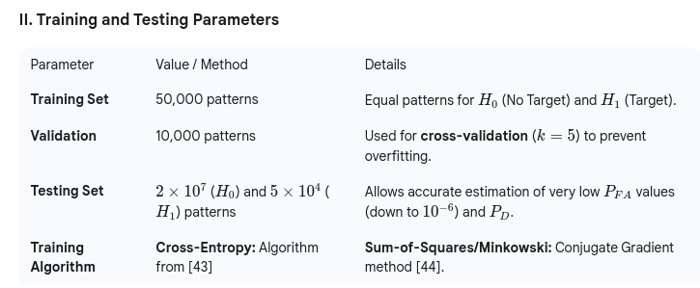
Experiments

Slide 12
Experiments
The final approximation error depends on the error function, training/validation sets, system structure, and training algorithm.
For a good approximation, the training set must be a subset of the input, the predicted function (implemented by the learning machine) must be sufficiently general to minimize the error function and the learning algorithm must effectively find the minimum of the error function.

Slide 13
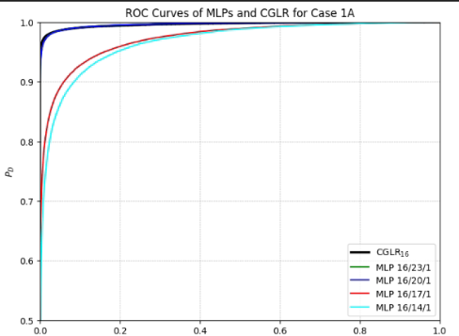
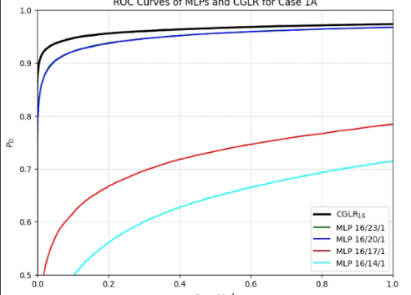
Results: Case 1A
ROC curve for Gaussian Targets with
Cross-Entropy error
Zoomed version given below

Slide 14
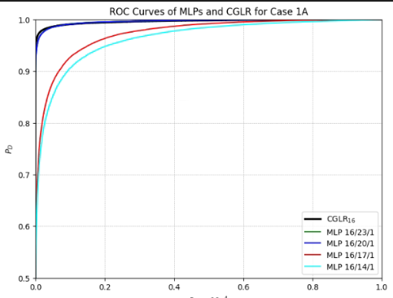
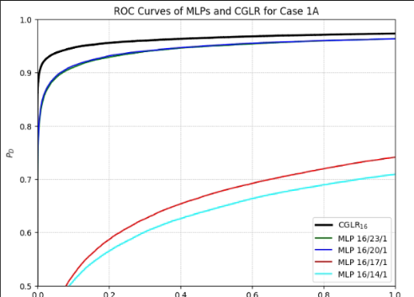
Results: Case 1A
ROC curve for Gaussian Targets with
Sum of Squared Error

Slide 15
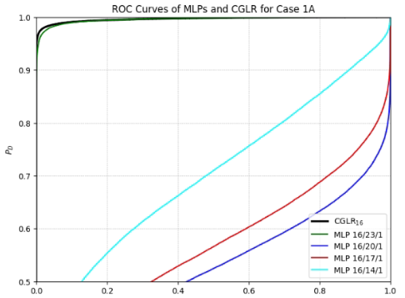
Results: Case 1A
ROC curve for Gaussian Targets with
Minkowski error R = 1

Slide 16
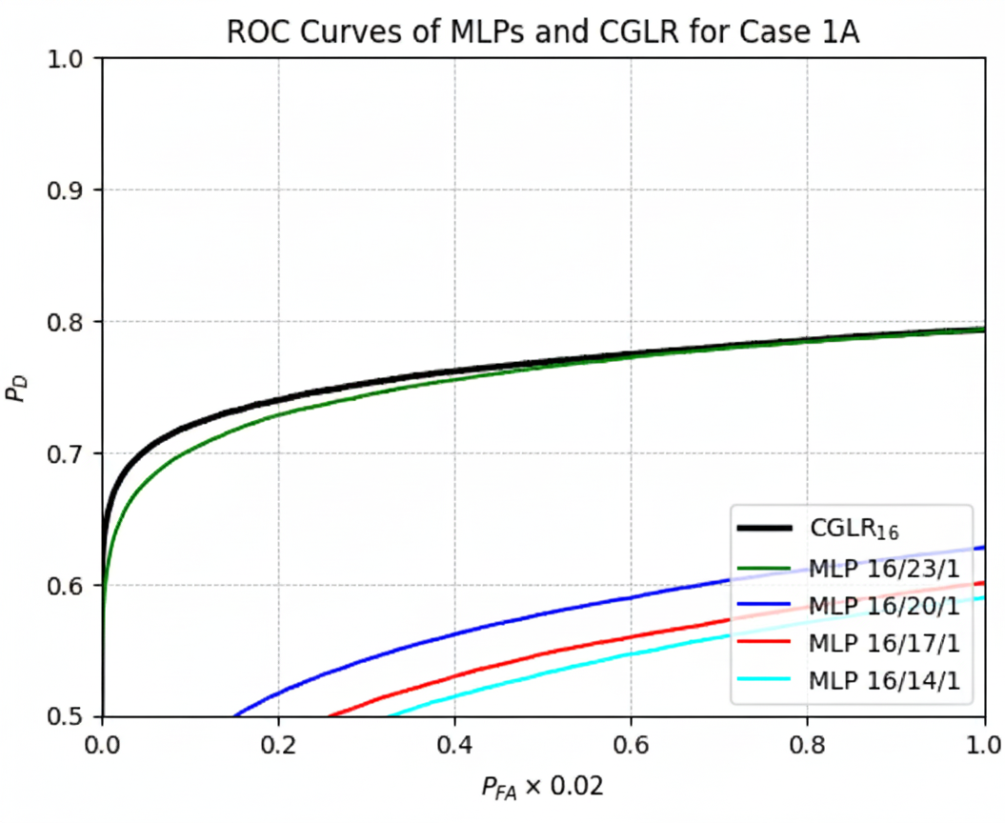
Case 1B: ROC curve for SW1 with Cross-Entropy Error
Local Trend (Zoomed Version)

Slide 17
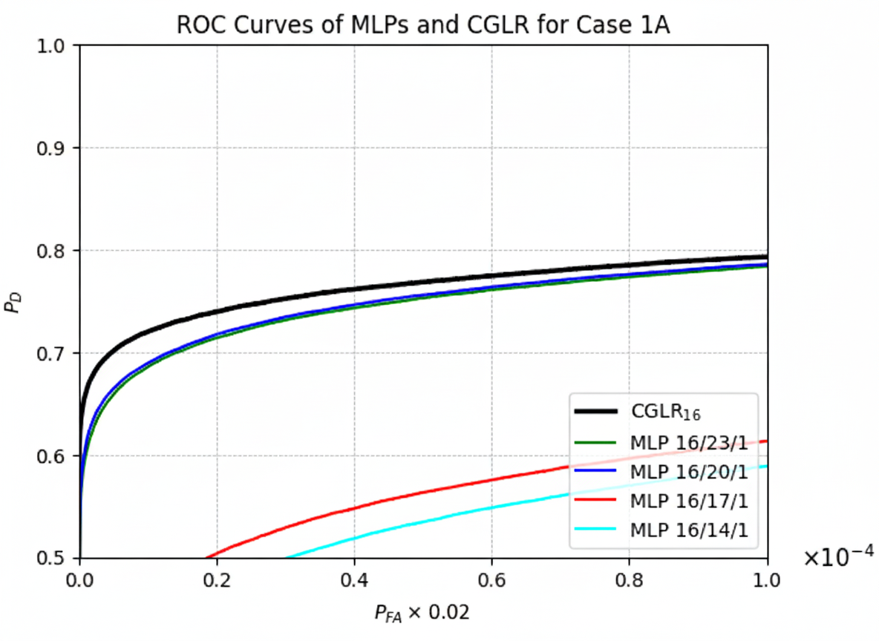
Case 1B: ROC curve for SW1 with Sum-of-Squares Error
Local Trend (zoomed version)

Slide 18
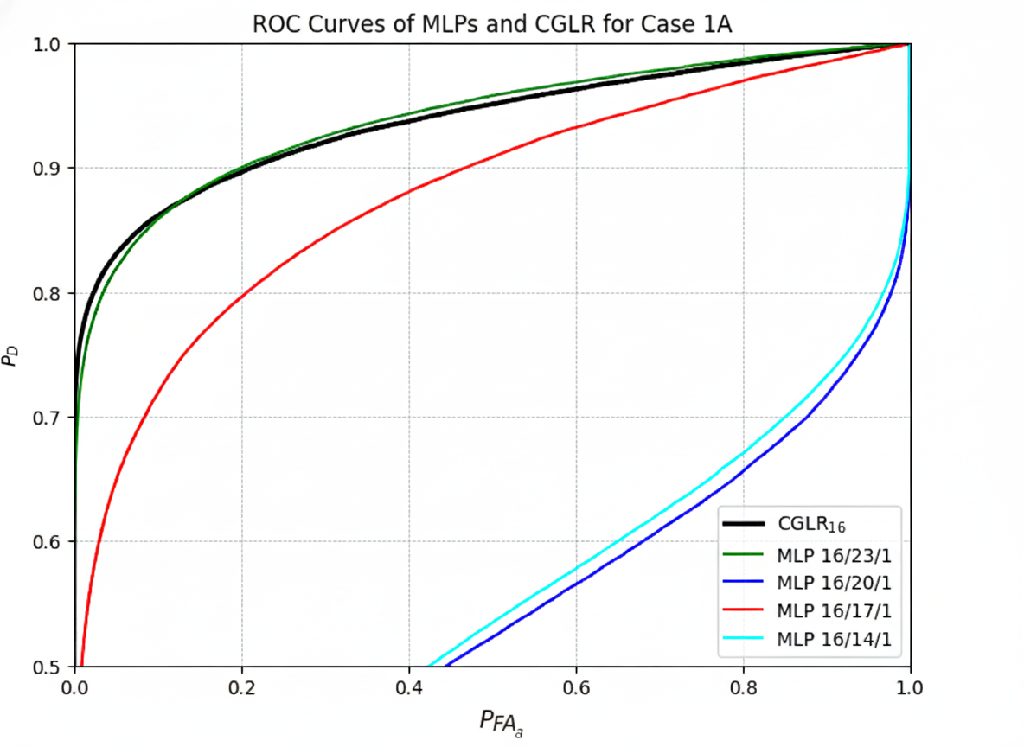
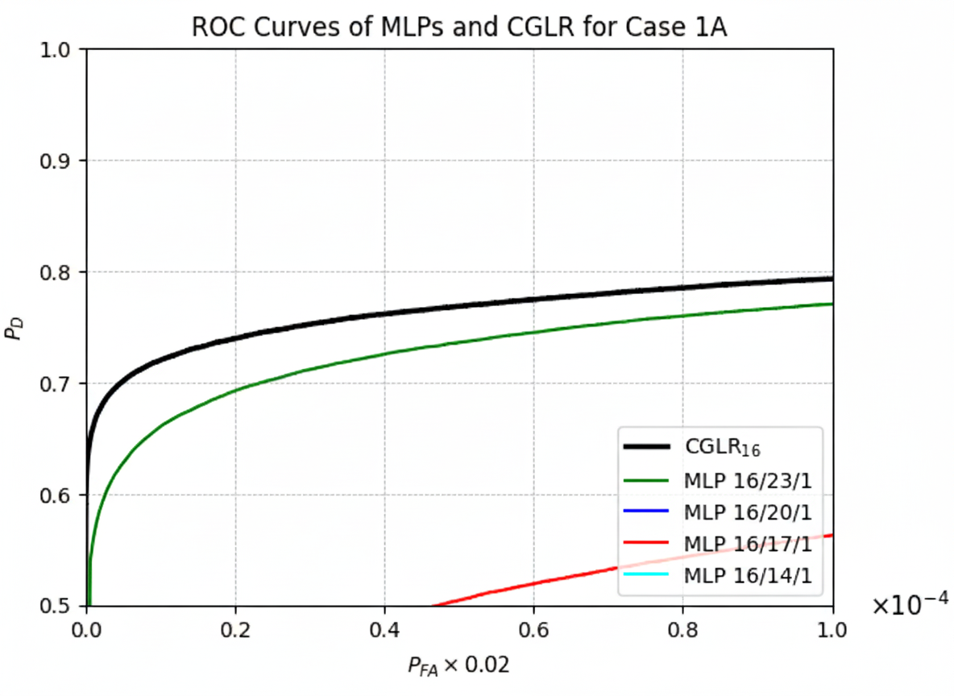
Case 1B: ROC curve for SW1 with Minkowski Error (for R=1)
Local Trend (zoomed version)

Slide 19
Future Works
Generate the ROC plots for Case-2 and Case-3 for A and B subcases.
Plot P_{D} VS SNR for all the 3 types of error
Finding an innovation for this proposal.

Slide 20
THANK YOU

